Slide 1
Neural networks by examples

Slide 2


Slide 3

Where?

Slide 4

Where (2) ?

Slide 5
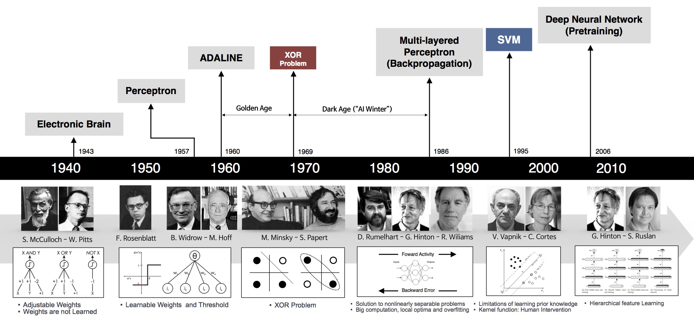
When & Who

Slide 6
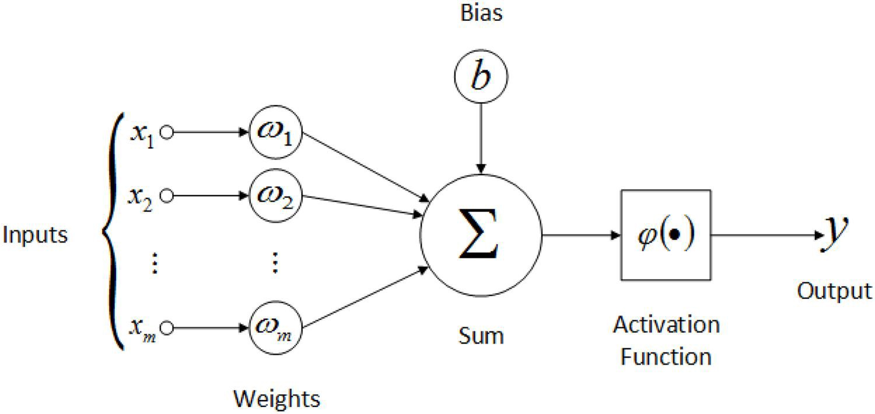
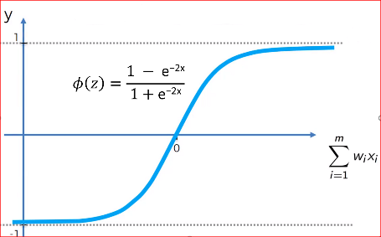
What

Slide 7

Why ANNs are important?
Neural nets are widely used because of their ability to generalize and to respond to unexpected inputs/patterns

Slide 8
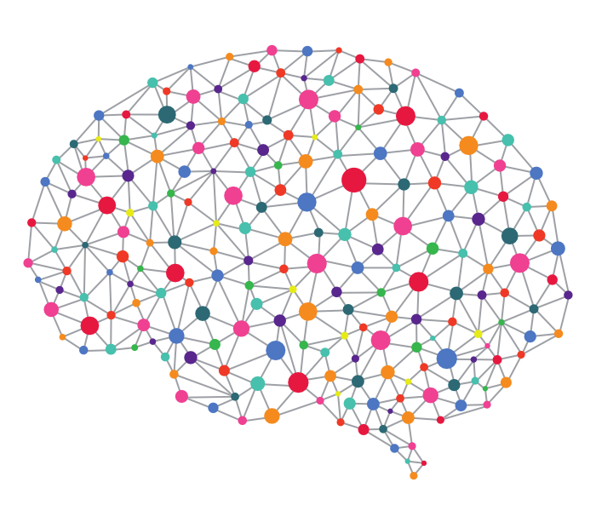
First neural net:
XNOR Processor

Slide 9
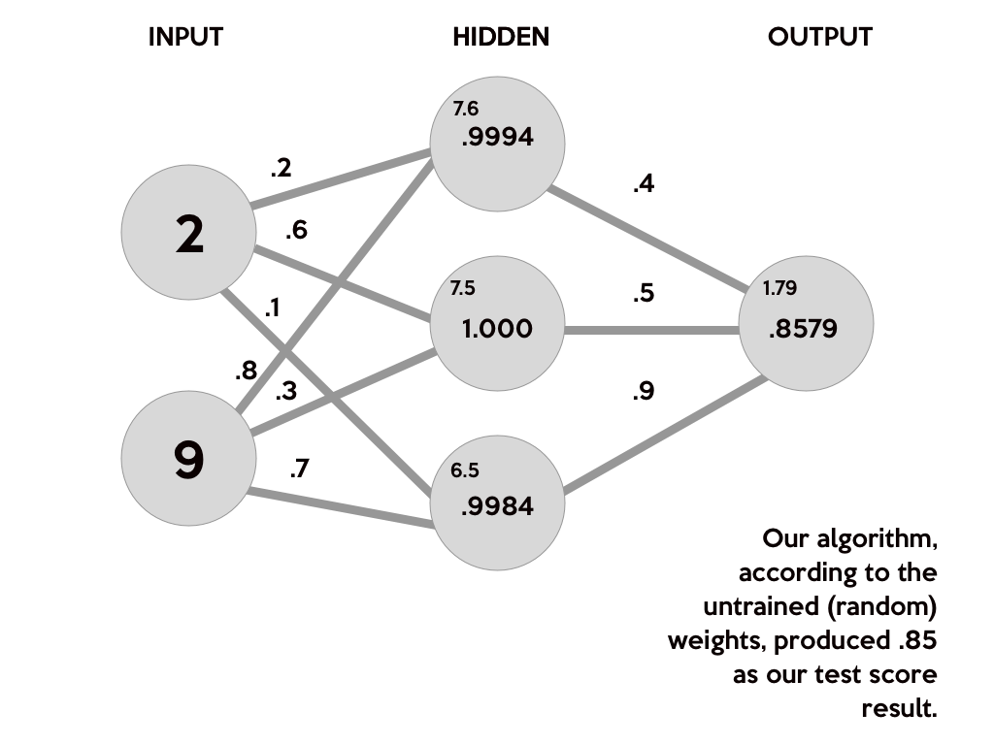
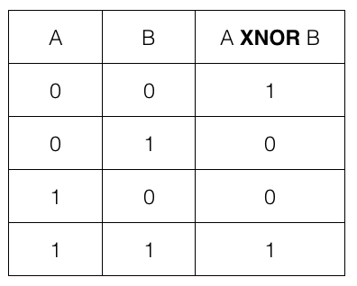
The network

Slide 10
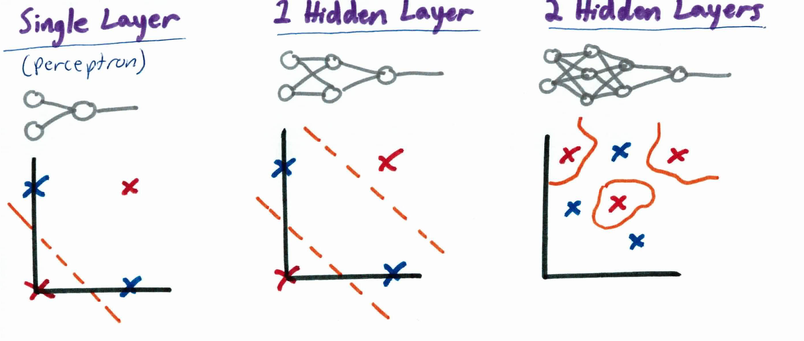
Non-linear classifier

Slide 11



Let’s code!

Slide 12


IBM or HCL?
Example of CNN classifier

Slide 13

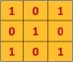

Convolutional neural networks

Slide 14
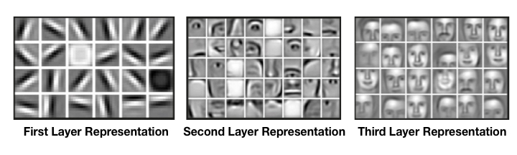
Convolutional neural networks

Slide 15
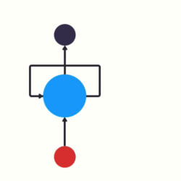
Recurrent neural net

Slide 16

Recurrent neural networks

Slide 17
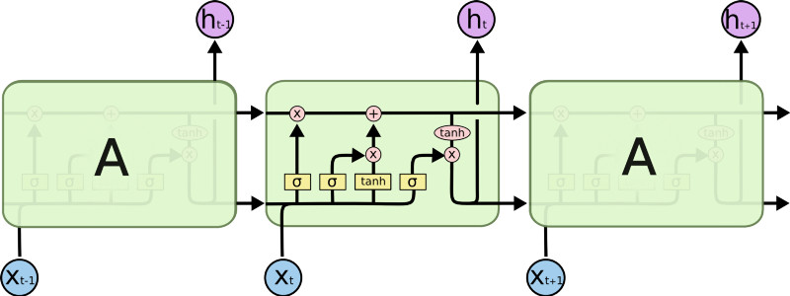
Recurrent neural networks (LSTM)

Slide 18
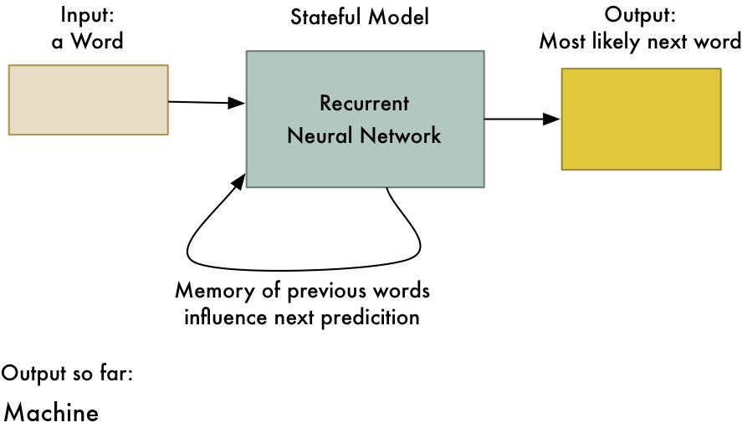
Recurrent neural networks (LSTM)

